Slide 1
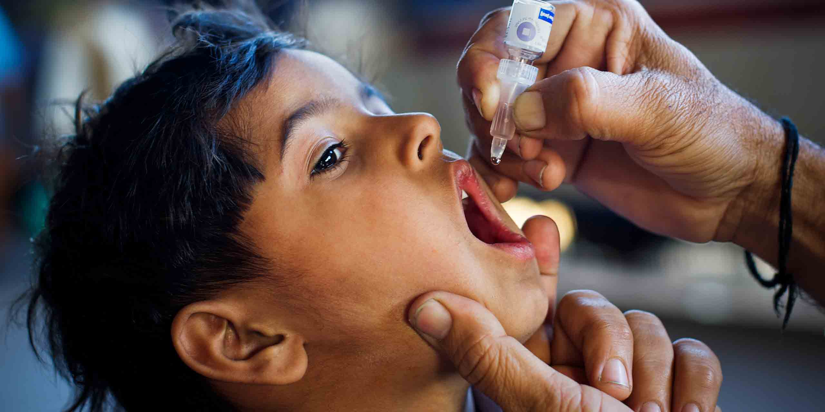
Pulse Polio Programme

Slide 2
What is Polio?
• Polio is a crippling and potentially deadly disease.
• Caused by poliovirus, mainly affecting children.
• Spreads through contaminated food and water.
• Can lead to permanent paralysis.
World Polio Day on 24th October

Slide 3
Objectives of Pulse Polio Programme
• Administer OPV to all children <5 years.
• Interrupt poliovirus transmission.
• Maintain population immunity.
• Achieve and sustain polio-free status.
OPV – Oral Polio Vaccine

Slide 4
Pulse Polio Implementation Strategy
National Immunization Day
16th March 1995
Transit Team Coverage
Railway stations, Bus Stops, Crowded areas
Booth-based Vaccination
AFP Surveillance
(Acute Flaccid Paralysis)
House-to-House Coverage

Slide 5
Pulse Polio Timeline
• 1978: EPI (Expanded Programme on Immunization)
• 1985: UIP (Universal Immunization Programme)
• 1995: Pulse Polio Launch
• 2011: Last Polio Case
• On 27th March 2014 WHO declared India as Polio-free

Slide 6
Cold Chain and Logistics
• Essential for maintaining vaccine potency.
• Includes ILRs, cold boxes, and carriers.
• Monitored at every level of vaccine delivery.

Slide 7
Stakeholders in Pulse Polio
MoHFW
WHO
UNICEF
Rotary International
Health Workers

Slide 8
Monitoring & Surveillance
• AFP Surveillance System
• Lab confirmation of cases
• Mobile tech for real-time tracking

Slide 9
Challenges Faced
• Reaching remote areas
• Misinformation and hesitancy
• Migratory populations
• Sustaining high coverage

Slide 10
Success and Current Status
• India free from wild poliovirus since 2011
• Robust routine immunization ongoing
• Continued National Immunization Days
• Vigilance against importation

Slide 11
Conclusion
• A remarkable public health achievement
• Collective effort of multiple sectors
• Model for disease eradication
• Sustained efforts needed to prevent re-emergence

