Slide 1
UNIT - V
BASICS OF PHYTOCHEMISTRY
Methods of extraction
Applications of latest techniques
Spectroscopy
Chromatography
Electrophoresis

Slide 2
Basics of Extraction
Extraction is defined as the process of isolation of soluble material from an insoluble residue which may be liquid or solid by treatment with a solvent on the basis of the physical nature of crude drug to be extracted that is liquid or solid the extraction process may be liquid – liquid or solid– liquid extraction.
Extract : Extracts can be defined as preparations of crude drugs which contain all the constituents which are soluble in the solvent.
Marc : Solid residue obtain after extraction
Menstrum : Solvent used for extraction

Slide 3
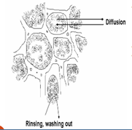
Plants constituents are usually contained inside the cells. Therefore, the solvent used for extraction must diffuse into the cell to dissolve the desired compounds whereupon the solution must pass the cell wall in the opposite direction and mix with the surrounding liquid.
An equilibrium is established between the solute inside the cells and the solvent surrounding the fragmented plant tissues.

Slide 4
Ideal properties of the solvents:
Be highly selective for the compound to be extracted.
Not react with the extracted compound or with other compounds in the plant material
Low toxicity
Inert and Inflammable
Be harmless to man and to the environment.
Be completely volatile
The density of solvent should be different from water density.

Slide 5
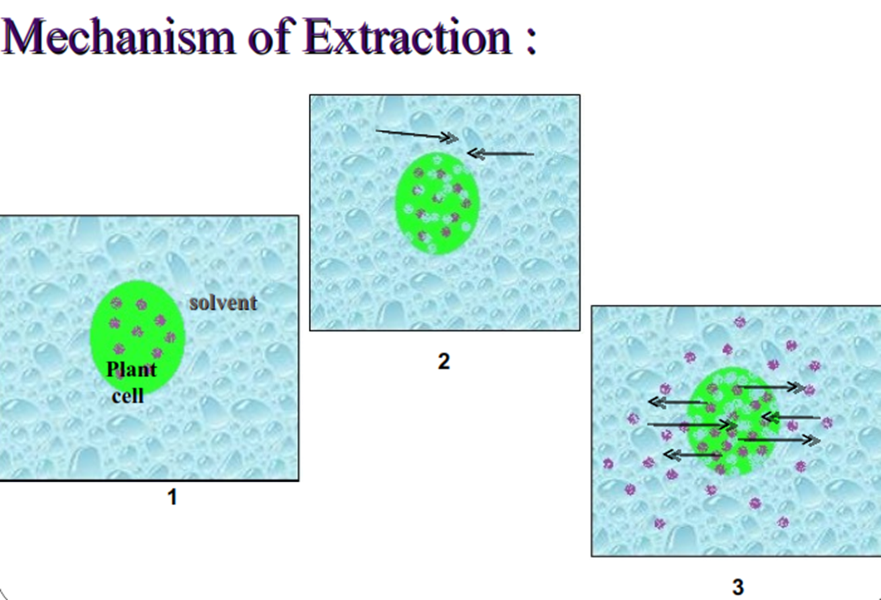
Mechanism of Extraction

Slide 6
Factors affection extraction process
Nature of drug
Solvent
Temperature
pH
Particle size

Slide 7
Extraction
Non-volatile plant constituent extraction
Volatile plant constituent extraction
Conventional method
Modern method
Conventional method
Modern method
Maceration
Infusion
Digestion
Decoction
Percolation
Soxhlet
Reflux
Sonication
Microwave assisted
Supercritical fluid
Pressurized liquid extraction
Counter current
Distillation
Enzyme method
Extraction
Expression
Super critical fluid
Solid phase micro
Microwave hydrodiffusion

Slide 8
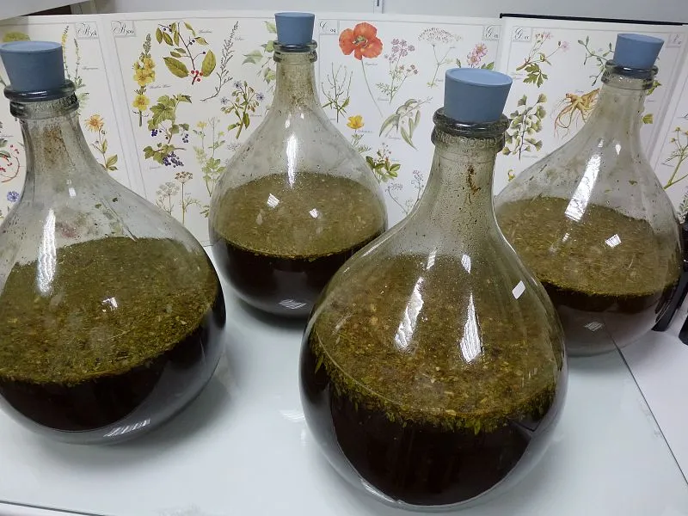
MACERATION
In this process solid ingredients are placed in a stoppered container with the whole of the solvent and allowed to stand for a period of at least 3 days (3-7 days) with frequent agitation, until soluble matter is dissolved. The mixture is then strained, the marc pressed and the combined liquids clarified ( cleaned by filtration) or by decantation after standing.

Slide 9
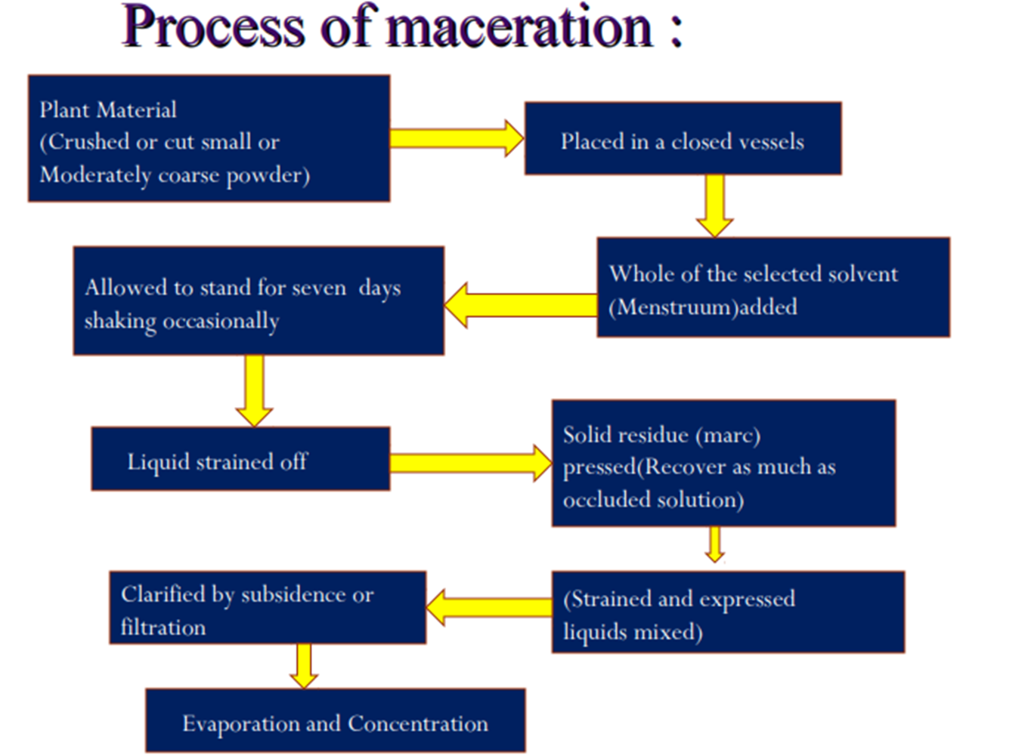
Process of Extraction

Slide 10
Modifications to Maceration
The maceration method is modified to multiple stage extraction to increase the yield of the active ingredients in the extracts.
Modified Maceration : is used for unorganised drug like gums and resins.
pressing is avoided.
Fresh menstrum is used to wash marc and makeup the volume.
Multiple Maceration : to obtain concentrated extract, total menstrum is divided into 2 parts or 3 parts (double or triple maceration ) and each part is used for maceration separately.
Vacuum Maceration : when pressure is reduced to desired extent, Menstrum is allowed to enter Increases permeability of cell walls Reduce extraction time

Slide 11
Modifications to Maceration
Kinetic Maceration : The vessel is agitated in constant motion for first 24 hours
20-50% more yield usually
Re-Maceration : first maceration is carried with small amount of menstrum followed by remaining amount of solvent.
Circulation Maceration : solvent is continuously circulated by pump.

Slide 12
Merits
Small sample size.
Strong swelling properties or high mucilage.
Energy saving process.
Demerits
Not exhaustively extract the drug.
It is very slow process.
Solvent required is more.

Slide 13
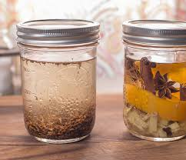
INFUSION
It is used for extraction of vitamins, volatile ingredients and soft ingredients in which the powdered drug is extracted with hot/cold water
Plant material is macerate for short period of time
It is a type of periodic maceration
soak powdered drug in hot/ lukewarm water for
specified period with/without stirring
Filter
Press the marc
Extract again with fresh hot/lukewarm water

Slide 14
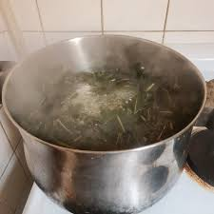
DECOCTION
This is the ancient and more popular process of extracting water soluble and heat stable constituents from crude drugs by boiling them in water for 15 minutes.
The boiled crude drug-water mixture is then cooled, then filtered and sufficient volume of cold water is added.
Eg ;- Tea, Coffee

Slide 15
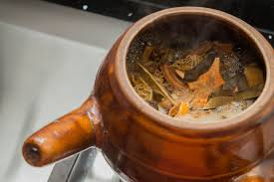
DIGESTION
Digestion is also a type of maceration in which moderate heating is preferred during extraction.
It is preferred for drugs in which the use of moderately elevated temperature does not cause the degradation of constituents.
Eg: Belladona tincture
Benzoin tincture and sweet orange peel tincture

Slide 16
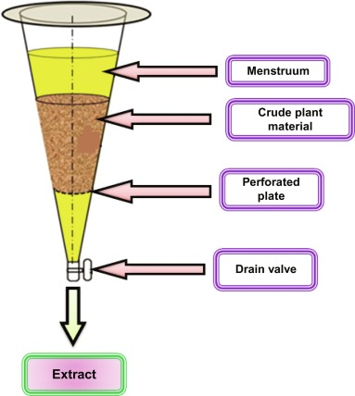
PERCOLATION
It is continuous downward displacement of the solvent through the bed of crude drug material to get extract.
Most frequently used to extract active ingredients in the preparation of tinctures and fluid extracts.
It is the method of short successive maceration or process of displacement
A percolator ( a narrow, cone-shaped vessel open at both ends) is generally used.

Slide 17
STEPS IN PERCOLATION
SIZE REDUCTION
The drug to be extracted is subjected to suitable degree of size reduction, usually from coarse to fine powder
IMBIBITION
Powdered drug is moistened with a suitable amount of menstrum and allowed to stand for 4 hours in a well closed container
PACKING
After imbibition the moistened drug is evenly packed into the percolator
PERCOLATION
The lower tap is opened and liquid collected therein is allowed to drip slowly at a controlled rate until 3/4th volume of the finished product is obtained.
MACERATION
After packing sufficient menstrum is added to saturate the material. The percolator is allowed to stand for 24 hours to macerate the drug

Slide 18
TYPES OF PERCOLATION
Simple Percolation :
Eg :- i) Tincture of belladona
ii) Compound tincture of cardamom
Modified Percolation :
Repeated maceration is more effective than simple.
Multiple maceration – solvent divided into equal multiple time considering the solvent retained by plant tissue.
Used to prepare concentrated preparation.
Drug (200gms)
Imbibition for 4 hours
Maceration for 24 hours
Percolation an collect i.e., 3/4th of the volume of finished preparation

Slide 19
Reserved Percolation :
In this case the extraction is done through the general percolation procedure.
At the last, the evaporation is done under reduced pressure in equipment like climbing evaporator to the consistency of a soft extract (semi-solid) such that all the water is removed.
This is then dissolved in the reserved portion which is strongly alcoholic and easily dissolves the evaporated portion with any risk of precipitation.

Slide 20
Merits
Requires less time than maceration.
Extraction of thermolabile constituents can be possible.
Demerits
Requires more time than soxhalation.
More solvent is required.
Skilled person is required.

Slide 21
MACERATION vs PERCOLATION
Maceration
Percolation
Time consuming and also extraction is not complete.
Not required skilled operator.
For certain substances which are very less soluble in solvent and requires only prolonged with solvent.
Suitable method for less potent and cheap drugs.
Short time and more complete extraction.
Skilled operator is required
Special attention should be paid on particle size of material and throughout process.
Suitable method for potent ad costly drugs.

Slide 22
SOXHLET EXTRACTION
Advantages
Disadvantages
Large amount of drug can be extracted with small quantity of solvent
More economical
Small scale used as batch-process
Physical nature of drug
Chemical nature of drug effects
Solvent

