Slide 1

Oral Contraceptives KRVS Chaitanya

Slide 2
Action of hormone
Estrogen primarily inhibits ovulation (decreases LH and FSH), but also causes changes in the endometrium that make it less receptive to implantation, and inhibits ovum transport.

Slide 3
Progestin also inhibits ovulation, but also thickens cervical mucus, changes secretions in Fallopian tubes, and reduces the chance of implantation
The lower the concentration of estrogen, the fewer side effects, since most are estrogen-related

Slide 4
Oral contraceptives
Combined pill
Phased pill
Mini pill
Post coital pill

Slide 5
Combined hormonal contraceptive (Pills)
Combined hormonal contraceptive pills (most common type of birth control pills)
Contain both estrogen and progestin in pills to be taken orally
Early types of pills had 21 pills with equal amounts of hormones, with or without 7 pills with no hormones

Slide 6
Sequential (or tricyclic) pills (see graph) have varying amounts of hormones to more closely mimic natural hormone production, allowing lower concentrations of hormones to be used
Require the ability to remember to take the pills regularly every day

Slide 7
Combined hormonal contraceptive (patches and vaginal rings)
Contain both estrogen and progestin that diffuse from the patch or ring continuously
Require a prescription, but the woman can change the patches or rings herself
Each patch is left on 7 days--after three weeks/patches, no patch is used for a week, during which the woman menstruates--then a new patch sequence begins

Slide 8
Vaginal rings (NuvaRing) are inserted into the vagina (no special location required) and left there for three weeks, and then removed for a week for menstruation--then a new ring is inserted
Failure rate is about 3/1000 for both patches and rings

Slide 9
Rings can be left in the vagina for up to four weeks, but after that they are no longer effective and should be removed.
If the rings come out, they can be washed and reinserted, most women are able to conceive within 3 months after ceasing to use patches or rings

Slide 10
Practical considerations
Discontinuation of all OCs results in full return of fertility within 1–2 months. There may even be a rebound increase in fertility—chances of multiple pregnancy are more if conception occurs within 2–3 cycles. With injectable preparations, return of fertility is delayed. The cycles take several months to normalize or may not do so at all.

Slide 11
If a woman on combined pills misses to take a tablet, she should be advised to take two tablets the next day and continue as usual. If more than 2 tablets are missed, then the course should be interrupted, an alternative method of contraception used and next course started on the 5th day of bleeding.

Slide 12
If pregnancy occurs during use of hormonal contraceptives—it should be terminated by suction-aspiration, because the risk of malformations, genital carcinoma in female offspring and undescended testes in male offspring is increased.

Slide 13
While for most women a pill containing 30 µg ethinylestradiol is sufficient, the obese may require a pill containing 50 µg, and only 20 µg may be appropriate/sufficient for those with cardiovascular risk factor, as well as for those above 40 yr age.

Slide 14
If breakthrough bleeding occurs—switch over to a pill containing higher estrogen dose.
In women with contraindications for estrogen , a progestin only contraceptive may be used.

Slide 15
Adverse Effects::
Since contraceptives are used in otherwise healthy and young women, adverse effects, especially long-term consequences assume great significance.
The adverse effects are dose dependent.
The following applies primarily to combined oral pill which has been most extensively used.

Slide 16
A. Nonserious side effect
These are frequent and then disappear gradually.
Nausea and vomiting: similar to morning sickness of pregnancy.
Headache is generally mild; migraine may be precipitated or worsened.
Breakthrough bleeding or spotting:
Breast discomfort.

Slide 17
B. Side effects that appear later
Weight gain, acne and increased body hair
Chloasma: pigmentation of cheeks, nose and forehead.
Pruritus vulvae is infrequent.
Carbohydrate intolerance/precipitation of diabetes .
Mood swings, abdominal distention are occasional.

Slide 18
C. Serious complications
Leg vein thrombosis and pulmonary embolism:
Coronary and cerebral thrombosis.
Rise in BP:
Estrogen tends to raise plasma HDL/LDL ratio (beneficial), but the progestin nullifies this benefit.

Slide 19
Genital carcinoma
Benign hepatomas
Gallstones

Slide 20
Danger signs
Noted by women using combined contraceptives
Severe pain in legs, chest, or abdomen
Severe unexplained headaches
Unexplained loss of vision
Reaction: stop using CC method, use some other form of contraception

Slide 21
Advantages of CHC
Extremely effective
Offer woman control over fertility and timing of menstruation
Safe for most women (but see below)
Women can take them for many years with no breaks required

Slide 22
Effects are reversible (average time to conceive 3 mth)
Reduction of menstrual pain and cramps, ovulatory pain
Reduced incidence of ovarian cysts (by 80-90%), anemia, PID, ovarian and endometrial cancer, ectopic pregnancies (not associated with melanomas)
Variable effect on PMS--worsens in some women, improves in others

Slide 23
Other health benefits
Apart from benefits due to prevention of unwanted pregnancy and the risks during delivery, use of oral contraceptives affords certain other beneficial effects as a bonus:

Slide 24
Lower risk of developing endometrial and ovarian carcinoma; probably colorectal cancer as well.
Reduced menstrual blood loss and associated anaemia; cycles if irregular become regular; premenstrual tension, dysmenorrhoea and menorrhagia are ameliorated.

Slide 25
Endometriosis and pelvic inflammatory disease are improved.
Reduced incidence as well as symptomatic relief of fibrocystic breast disease and ovarian cysts.

Slide 26
Disadvantages of CHC
Pills must be taken daily (requires good memory, regular schedule)
Expense may be high, depending on where the contraceptive is prescribed and the type
Menstrual cycle changes may be disconcerting

Slide 27
May have estrogen-related side effects: nausea, headaches, tender breasts, depression, acne, etc.
Estrogen may increase risk of blood clotting, cause slight increase in blood pressure

Slide 28
Slight increase in risk of breast cancer (esp. after 10 years) and cervical cancer (may be secondary to increased chance of STD's, which may be secondary to increased number of sexual partners

Slide 29
Contraindications
Women with history of cardiovascular disease (heart attack, stroke, etc.) or clotting disorders.
Women with history of breast cancer.
Women with chronic disease related to function of some major organ should consider using some other form of birth control

Slide 30
Myocardial infarction
Cerebrovascilar disease
Thrombophlebitis
Angina pectoris
Cancer of breast or sex organ
Unusual vaginal bleeding
Liver tumors or serious liver disease.
Thromboembolism

Slide 31
Another set of medicalconditions that are common in older wowen, makes pill use highly inadvisable. But Do not absolutely rule it out, if u have or have ever Had any of the following medical conditions.

Slide 32
Breast nodules
Family history of breast canacer
Diabetes
High blood preasure
High cholesterol

Slide 33
Cigarrette smoking
Migraine headaches
Heart kidney and liver diseases
Epilepsy
Depression

Slide 34
Fibroid tumors of The uterus
Gall bladders disease
Irregular menstrual periods

Slide 35
Women who are over 35 and smoke should use some other form of contraception

Slide 36
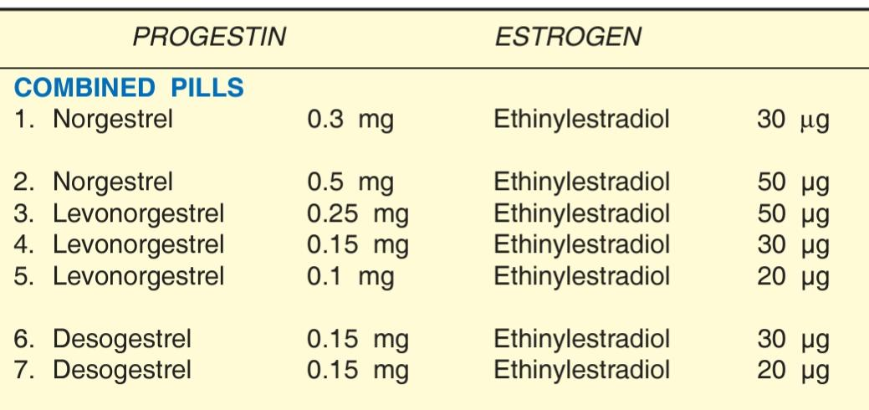
Regimen

Slide 37
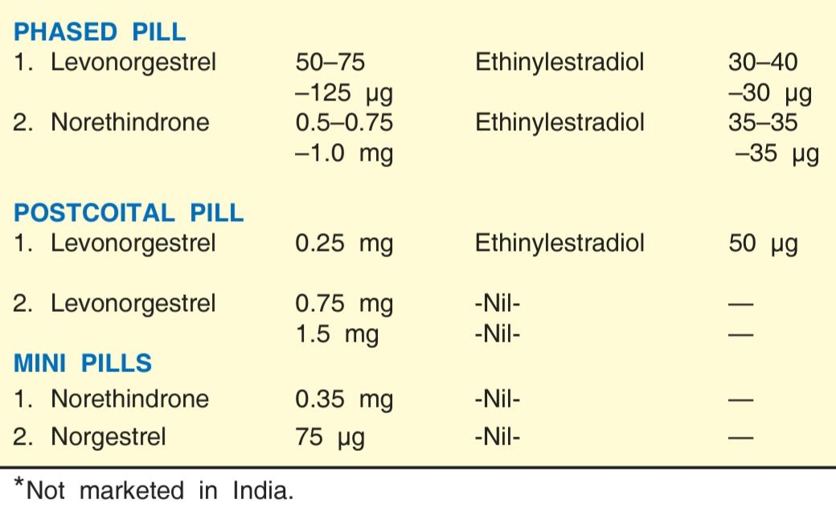

Slide 38
Ormeloxifene (Centchroman)
It is a nonsteroidal SERM developed at CDRI India as an oral contraceptive.
It has predominant estrogen antagonistic action in uterus and breast with little action on vaginal epithelium and cervical mucus.

Slide 39
Thank You

