Slide 1
Biopharmaceutics & Pharmacokinetics

Slide 2
Introduction
Biopharmaceutics : The study of factors influencing the rate and amount of drug that reaches the systemic circulation and the use of this information to optimise the therapeutic efficacy of drug products.
Absorption : The process of movement of drug from its site of administration to the systemic circulation.
Bioavailability : The rate and extent(amount)of drug absorption.
Drug distribution : The movement of drug between on compartment and to other (generally blood and the extra vascular tissues).
Elimination : The process that tends to remove the drug from the body and terminate its action.
occurs by 2 processes-
Biotransformation (metabolism): which usually inactivates the drug.
Excretion: which is responsible for the exit of the drug/metabolites from the body.

Slide 3
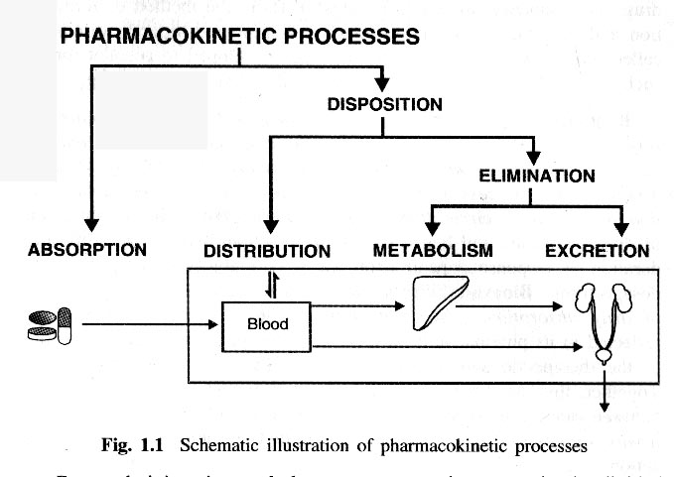
Pharmacokinetics: The study of time course of drug ADME and their relationship with its therapeutic and toxic effects of the drug.
Clinical pharmacokinetics: The use of pharmacokinetic principles in optimizing the drug dosage to suit individual patient needs and achieving maximum therapeutic utility.
Pharmacokinetic processes

Slide 4
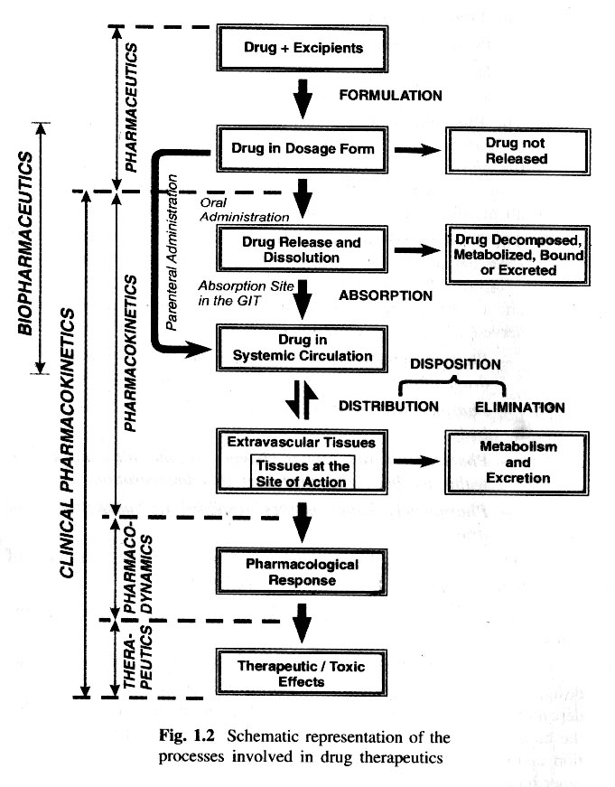
Drug administration and therapy divided into 4 phases or processes:
The pharmaceutical phase
The pharmacokinetic phase
The pharmacodynamic phase
The therapeutic phase

Slide 5
Absorption of drugs

Slide 6
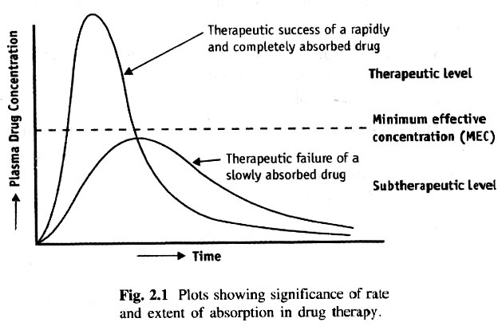
Drug absorption The process of movement of unchanged drug from the site of administration to systemic circulation. There always a correlation between the plasma concentration of a drug and the therapeutic response and thus, absorption can also be defined as the process of movement of unchanged drug from the site of administration to the site of measurement i.e., plasma.

Slide 7
Both the rate and extent of drug are important.
A rapidly absorbed drug attains the therapeutic level easily to elicit pharmacological effect. such absorption pattern has several advantages:
lesser susceptibility of the drug for degradation or interaction due to rapid absorption
Higher blood levels and rapid on set of action.
More uniform, greater and reproducible therapeutic response.
Drugs that have to enter the systemic circulation to exert their effect can be administered by three major routes :
The Enteral Route -Peroral (GIT, sublingual, buccal, rectal)
The Parental Route- Through or Under one or more layers of skin (IV, extra vascular like subcutaneous and intramuscular routes).
The Topical Route- Skin, eyes
NOTE : Intranasal, inhalation, intra vaginal and transdermal routes may be considered enteral or topical based on different definitions.

Slide 8
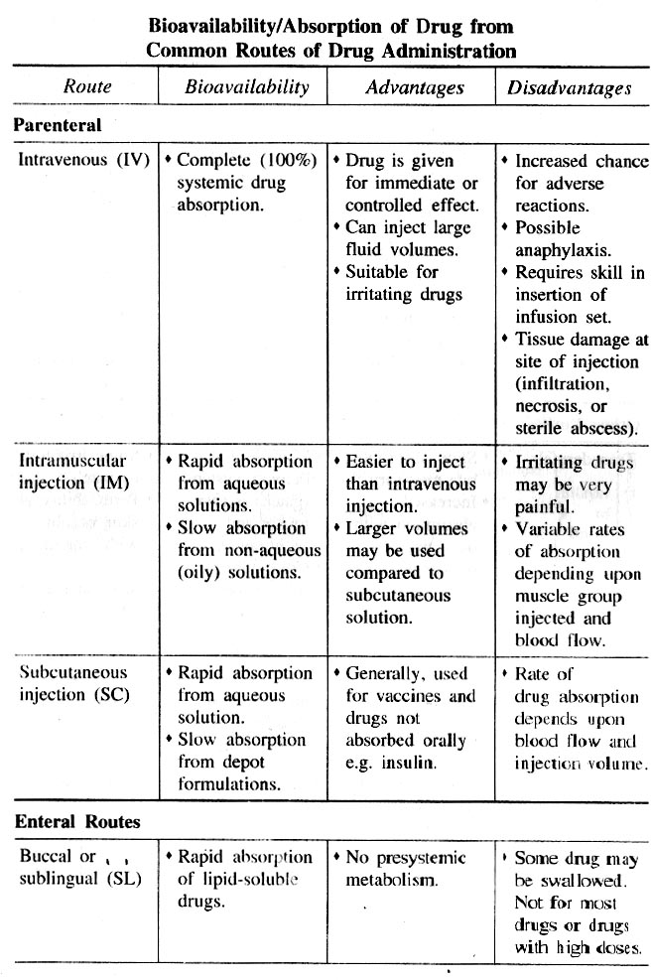

Slide 9
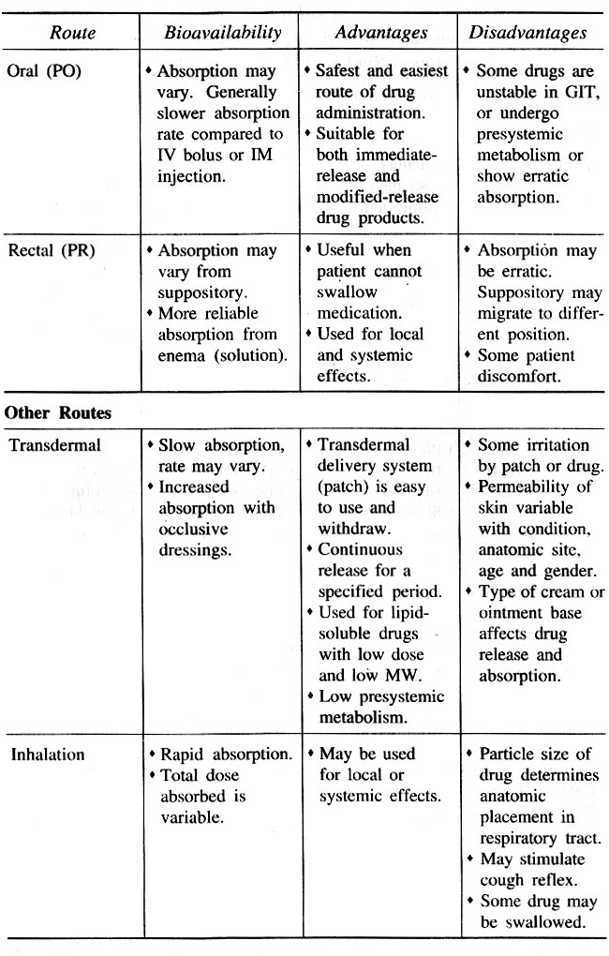

Slide 10
Gastrointestinal absorption of drugs

Slide 11
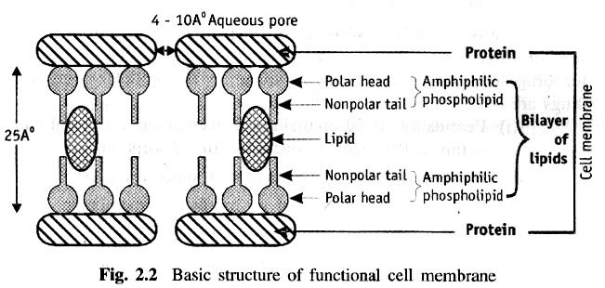
The oral route of drug administration is the most common for systemically acting drugs and therefore, more emphasis will be given to GI absorption of drugs.
Before proceeding to discuss absorption aspects, a brief description of cell membrane structure and physiology is necessary.
Cell Membrane: Structure and Physiology:
For a drug to be absorbed and distributed into organs and tissues and eliminated from the body, it must pass through one or more biological membranes/at various locations. Such a movement of drug across the membrane is called Drug Transport.
The basic structure of cell membrane consists of:
In which the hydrophobic core of the membrane is responsible for the relative impermeability of polar molecules. aqueous filled pores or perforrations of 4 to 10 Å in diameter are present in membrane structure through which inorganic ions and small organic water soluble molecules like urea pass.The biomembrane acts as a semipermiable barrier permitting rapid and limited passage of some compounds while restricting that of others.

Slide 12
Mechanism of drug absorption

Slide 13
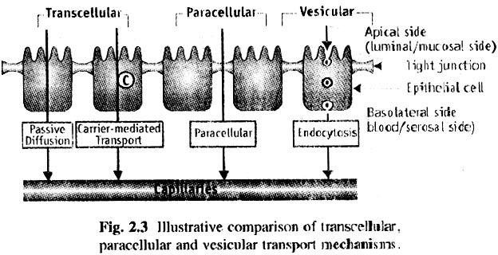
Types of Drug Transport Mechanisms in Drug Absorpion:
The three broad categories of drug transport mechanisms involved in absorption are:
Transcellular /intracellular transport
Paracellular/intercellular transport
Vesicular transport

Slide 14
Trancellular/Intracellular Transport:
It is defined as the passage of drugs across the GI epithelium. The three steps involved in transcellular transport of drugs are:
  Permeation of GI epithelial cell membrane, a lipoidal barrier –this is the major obstacle to drug absorption.
  Movement across the intercellular space(cytosol).
  Permeation of the lateral or basolateral membrane –this is of secondary importance.
  Types of Trancellular Transport:
  Passive Transport Processes
    Passive diffusion
    Pore transport
    Ion-pair transport
    Facilitated-or mediated diffusion
  Active Transport Processes
    Primary active transport
    Secondary active transport

Slide 15
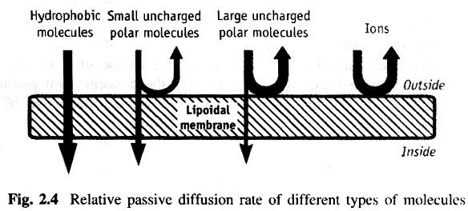
Types of Trancellular Transport:
Passive Transport Processes: do not require energy other than that of molecular motion(brownian movement) to pass through the lipid bilayer.
These can be further classified into:
Passive diffusion: also called as non-ionic diffusion. it is the major process for absorption of more than 90% of drugs. The driving force for this process is the concentration or electrochemical gradient. It is defined as the difference in the drug concentration on either side of the membrane.
It can be best expressed by Fick’s first law of diffusion.

Slide 16
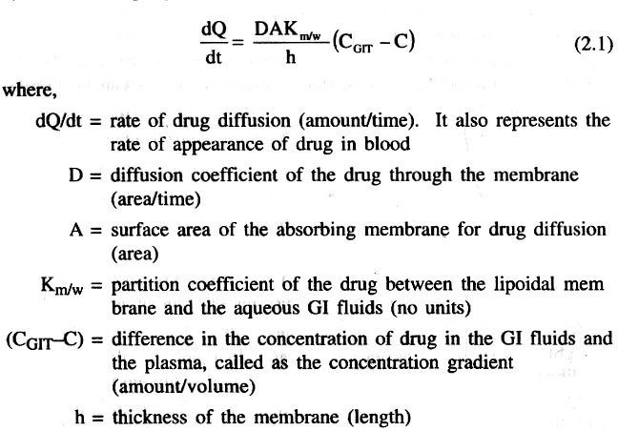
Fick’s first law of Diffusion – Passive diffusion

Slide 17

Initially, when the drug is ingested, C_{GIT} » G and a large concentration gradient exists thereby acting as the driving force for absorption. As equilibrium approaches, the drug diffusion should stop and consequently a large fraction of drug may remain unabsorbed. But this is not the case; once the passively absorbed drug enters blood, it is rapidly swept away and distributed into a much larger volume of body fluids and hence, the concentration of drug at the absorption site, C_{GIT} > is maintained greater than the concentration of drug in plasma. Such a condition is called as sink condition for drug absorption.
Since under usual conditions of absorption, D, A, K_{m/w} and h are constants, the term DAK _{m/w}/h can be replaced by a combined constant P called as permeability coefficient. Permeability refers to the ease with which a drug can penetrate or diffuse through a membrane. Moreover, due to sink conditions, the concentration of drug in plasma C is very small in comparison to C_{GIT} AS a result, equation (2.1) may be simplified to:

Slide 18
Pore transport- It is also called a s covective transport, bulk flow or filteration. This mechanism is responsible for transport of molecules into the cell through the protein channels present in the cell membrane.
Following are the characteristics of pore transport.:
1. The driving force is constituted by hydrostatic pressure or the osmotic differences across the mebrane due to which the bulk flow of water along wit solid molecules occurs through such aqueous channel. water flux that promotes such a transport is called as solvent drag.
2. The process is important in the absorption of low molecular weight , low molecular size and generally water soluble drugs through narrow, aqueous filled channels or pores in the membrane structure -- for example urea, water and sugars.
3. Chain like linear compounds of molecular weight upto 400daltons can be absorbed by filteration.
drug permeation through water filled channels is of particular importance in renal excretion, removal of drug from the cerebrospinal fluid and entry of drugs into the liver.

Slide 19
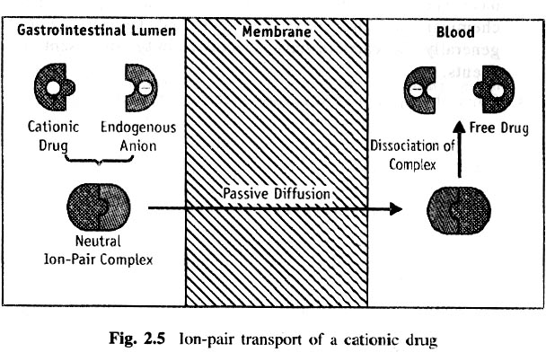
□Ion-pair transport-explains the absorption of drugs like quaternary ammonium compounds and sulphonic acids,which ionise under all pH conditions..
Propranolol, a basic drug that forms an ion pair with oleic acid is absorbed by this mechanism.

Slide 20
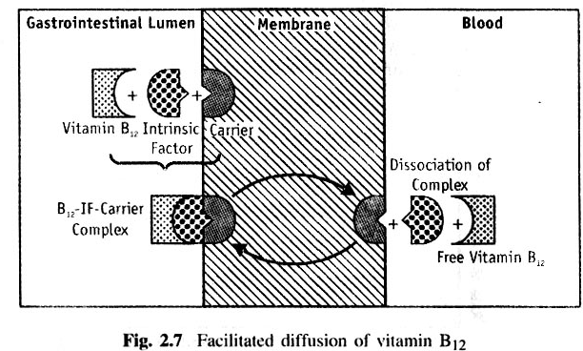
□Facilitated-or mediated diffusion –is a carrier mediated transport system that operates down the concentration gradient (downhill transport) but at a much faster rate than can be accounted by simple passive diffusion.the driving force is concentration gradient.

Slide 21
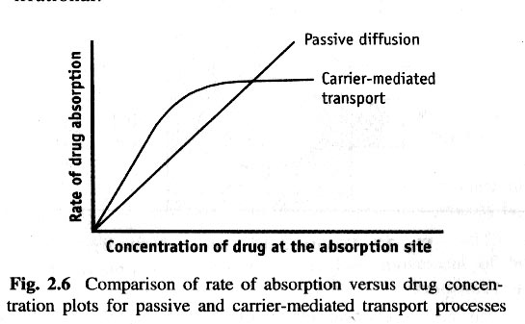

Slide 22
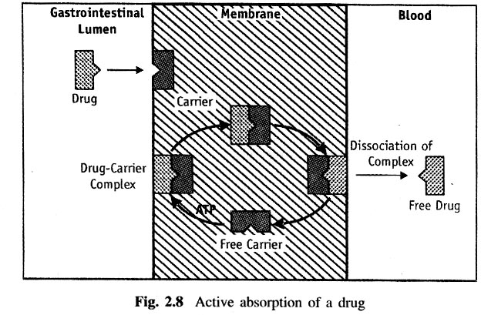
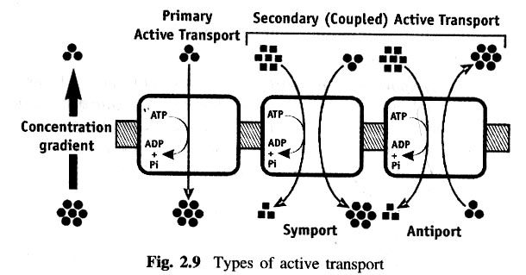
Active Transport Processes: require energy from ATP to move drug molecules from extracellular to intracellular milieu.
Types of Active Transport Processes:
□ Primary active transport-the process transfers only one ion or molecule and in only one direction , and hence called as uniporter (eg-absorption of glucose).
it is of 2 types:
Ion transporters
ABC(ATP-binding cassette) transporters.
□ Secondary active transport-this process is further subdivided into two:
Symport (co-transport)
Antiport (counter-transport )

Slide 23
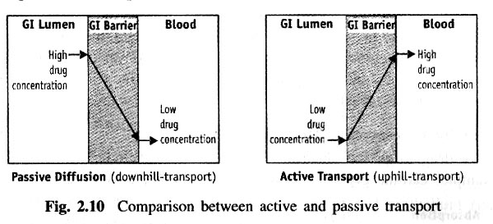

Slide 24
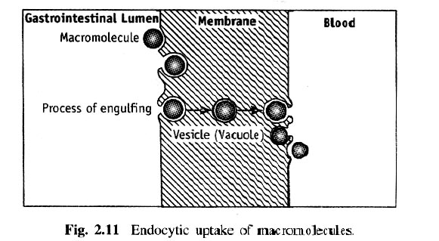
B. Paracellular/Intercellular Transport: is defined as the transport of drugs through the junctions between the GI epithelial cells. It has minor importance in drug absorption.
Types of Paracellular Transport Mechanisms:
Permeation through tight junctions of epithelial cells: occurs through openings which are a little bigger than the aqueous pores(eg-Insuin, cardiac glycosides).
Persorption: is permeation of drug through temporary openings formed by shedding of two neighboring epithelial cells into the lumen.
C. Vesicular or Corpuscular Transport(endocytosis): energy dependent processes but involve transport of substances within vesicles into a cell. This can be classified into 2 categories-
  Pinocytosis(cell eating)-adsorptive uptake of solid particulates.
  Phagocytosis(cell drinking)-uptake of fluid solute.

Slide 25
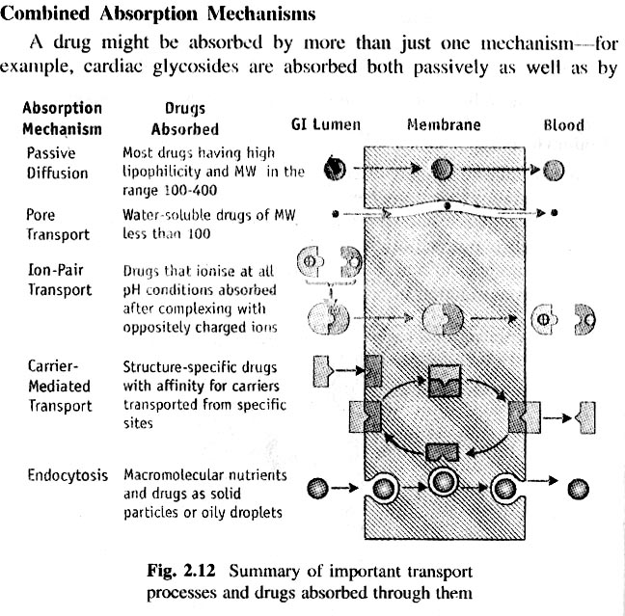

Slide 26
Phases of Drug Transfer from GI Absorption Site(GI Epithelium) into Systemic Circulation:
Absorption of drugs through the GI epithelium can be divided into three phase-
Pre-uptake phase: the 2 important pre-uptake processes are- a.Dissolution of drug in the GI fluids.
b.Metabolism of drug in the GI lumen-this can be affected by- i.Digestive enzymes present in the GIT, and/or
Bacterial enzymes in the colon.
  Uptake phase: the three processes involved in drug uptake are: a.Delivery of drug to the absorption site in the GIT.
b.Metabolism of drug by enzymes in the GI epithelium (gut wall metabolism). c.Passage of drug through the GI epithelium.
Post-uptake Phase: the three important post-uptake processes are:
Metabolism of drug by the liver, en route to the systemic circulation (first –pass hepatic metabolism).
Enterohepatic circulation of drug-during the first-pass through the liver, the drug may be excreted in the bile, re-enter the GIT via gall bladder and gets reabsorbed.
Transfer of drug into the systemic circulation.

Slide 27
Routes of Drug Transfer from the Absorption Site in GIT into the Systemic Circulation:
A drug is transferred from the absorption site into systemic circulation by one of two routes-
Splanchnic circulation: is the network of blood vessels that supply the GIT.
Lymphatic circulation: is a path of major importance in drug absoption into systemic circulation for two reasons:
The lymph vessels are less accessible than the capillaries.
The lymph flow is exceptionally slow.
Fats, fat-soluble vitamins and highly lipophilic drugs are absorbed through lymphatic circulation.
There are 3 advantages of lymphatic absorption of drugs:
  Avoidance of first-pass effect.
  Compounds of high molecular weight (above 16000)can be absorbed by lymphatic transport
  Targeted delivery of drugs to lymphatic system as in certain cases of cancer is possible.

Slide 28
