Slide 1
SAROJINI NAIDU VANITA PHARMACY MAHA VIDYALAYA (Co-Ed.) (Sponsored by the Exhibition Society) UGC AUTONOMOUS INSTITUTION AFFILIATED TO OSMANIA UNIVERSITY, APPROVED BY PHARMACY COUNCIL OF INDIA, NEW DELHI NBA ACCREDITED B.PHARMACY ( ISO 21001 : 2018 CERTIFIED INSTITUTE ) Accredited A+ Grade by NAAC
Sub: Biopharmaceutics & Pharmacokinetics
B Pharm VI Sem UNIT I MECHANISM OF ABSORPTION
Dr. S. Rohini Reddy
Department of Regulatory Affairs
Associate Professor

Slide 2
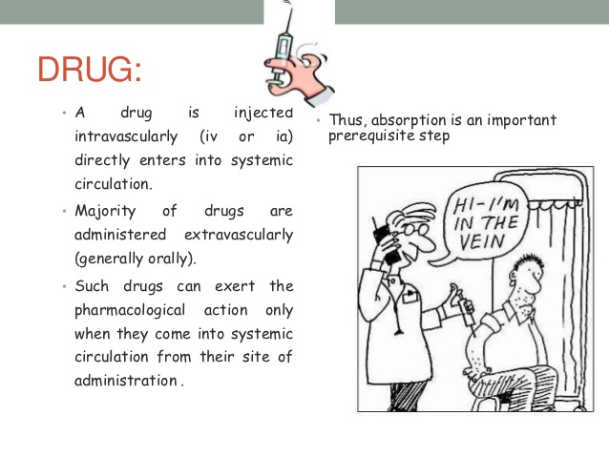

Slide 3
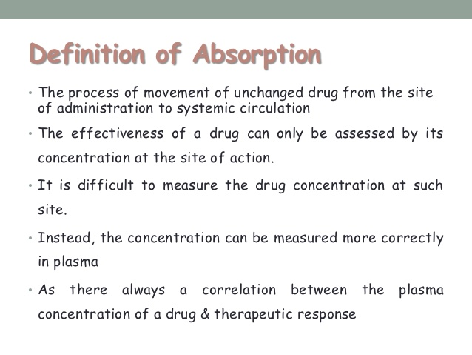

Slide 4
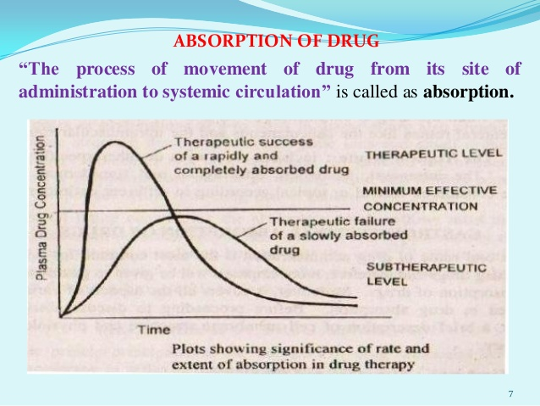

Slide 5
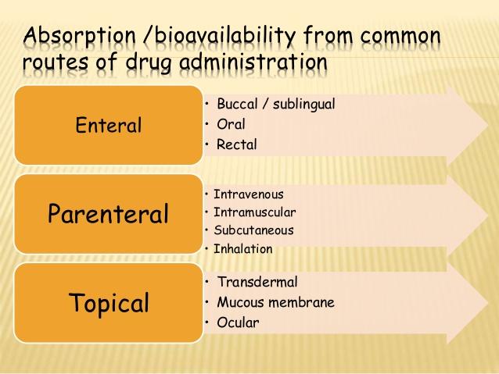

Slide 6
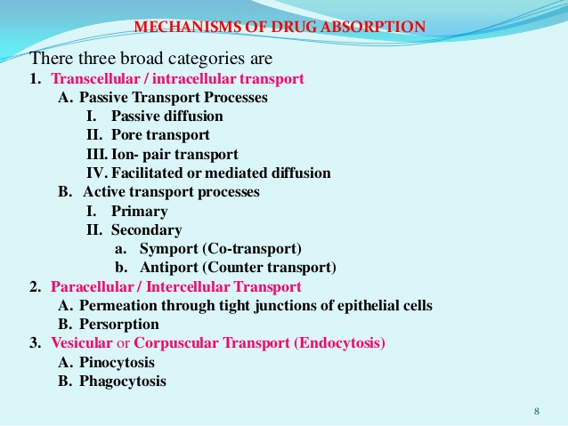

Slide 7
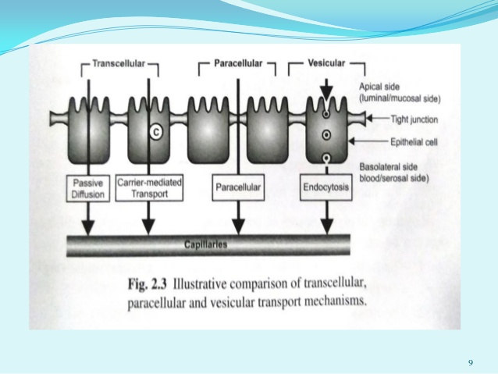

Slide 8
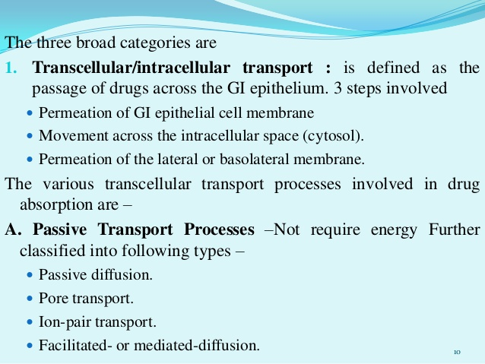

Slide 9
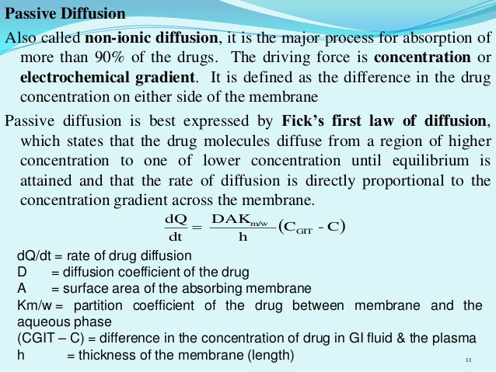

Slide 10
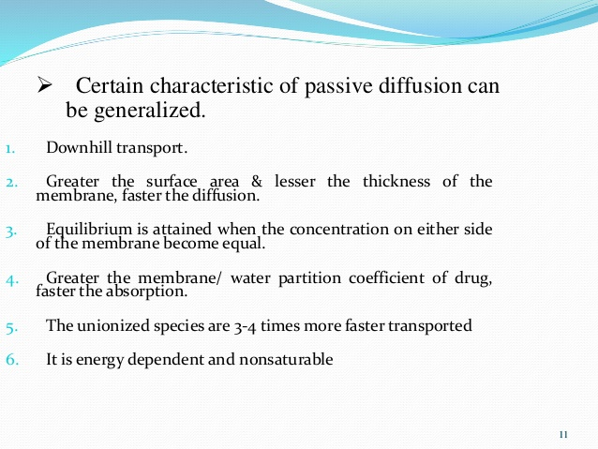

Slide 11
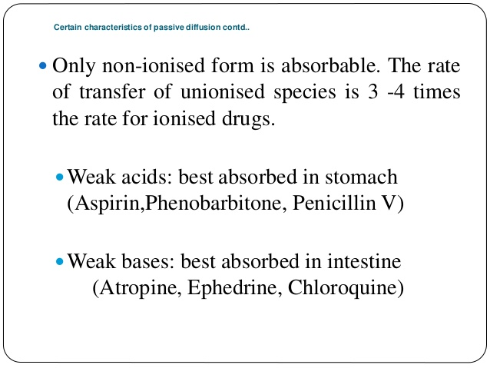

Slide 12
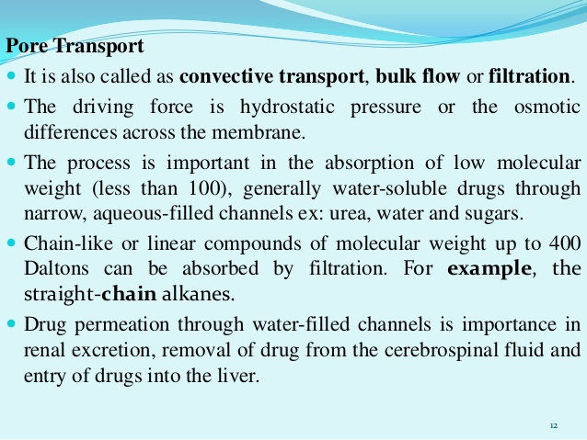

Slide 13
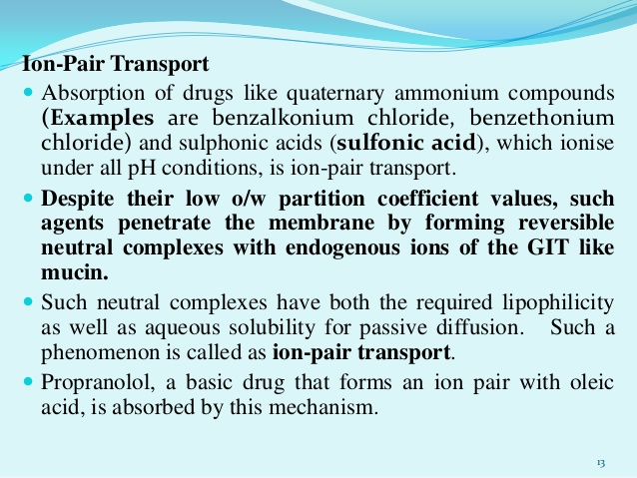

Slide 14
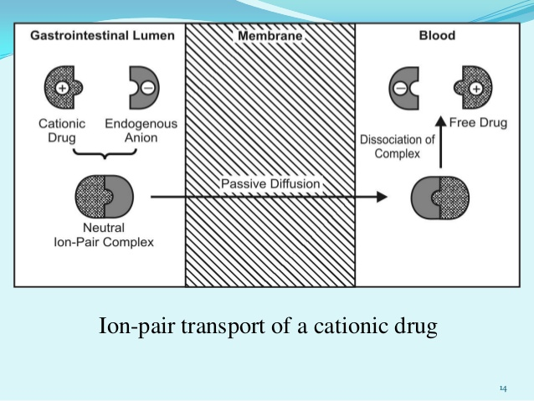

Slide 15
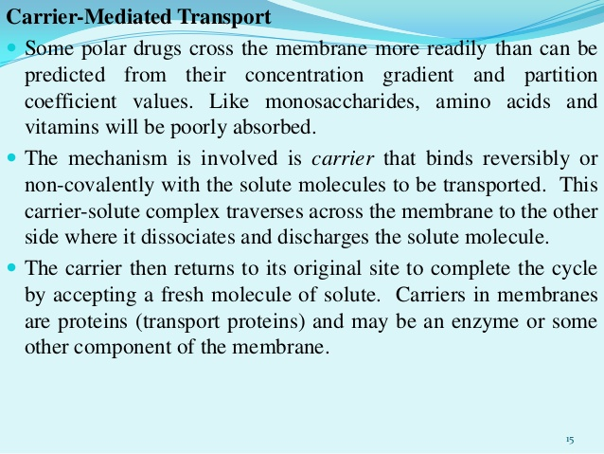

Slide 16
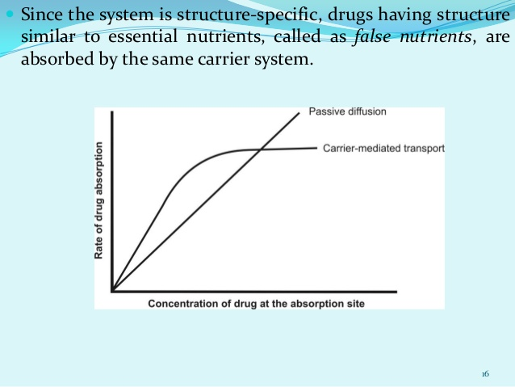

Slide 17
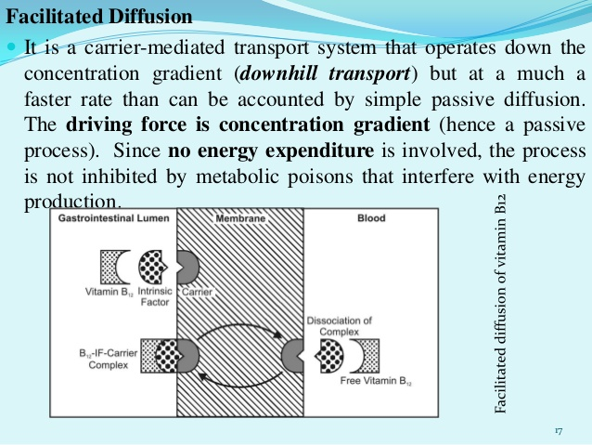

Slide 18
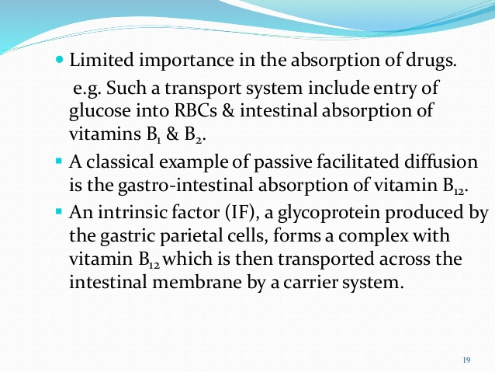

Slide 19
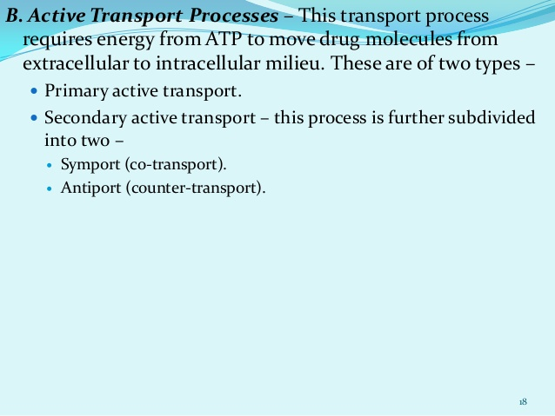

Slide 20
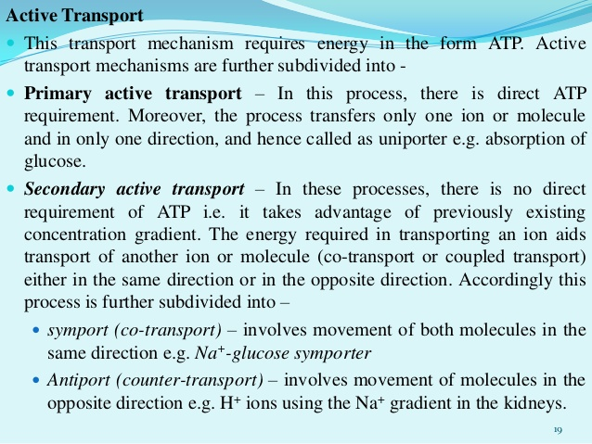

Slide 21
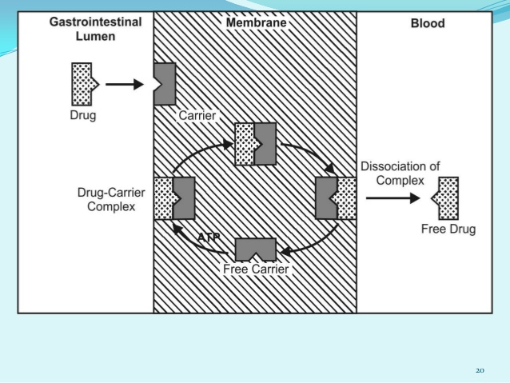

Slide 22
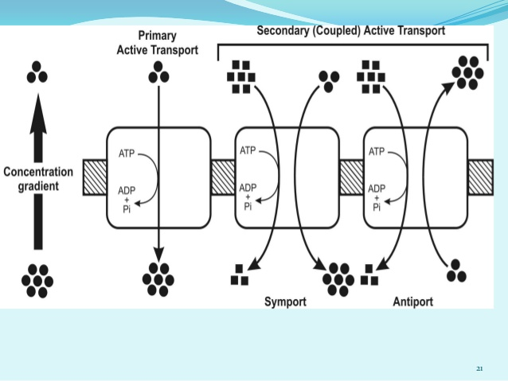

Slide 23
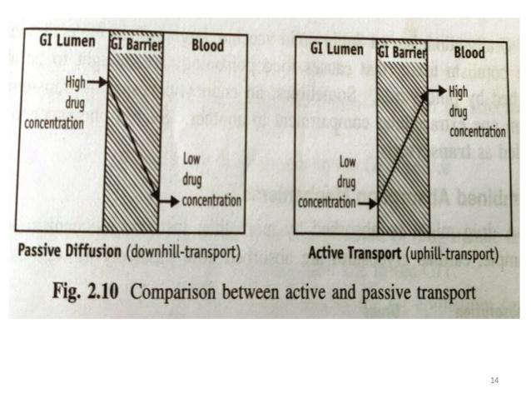

Slide 24
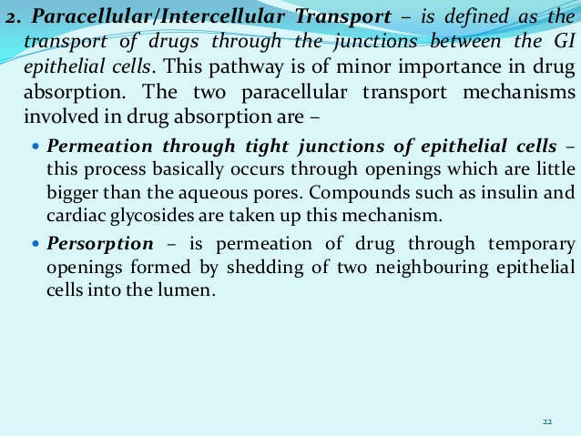

Slide 25
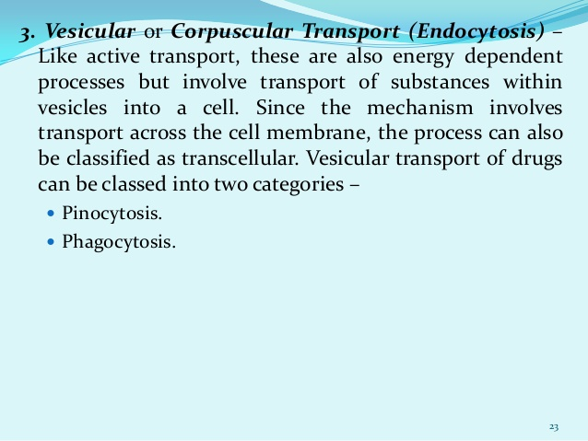

Slide 26
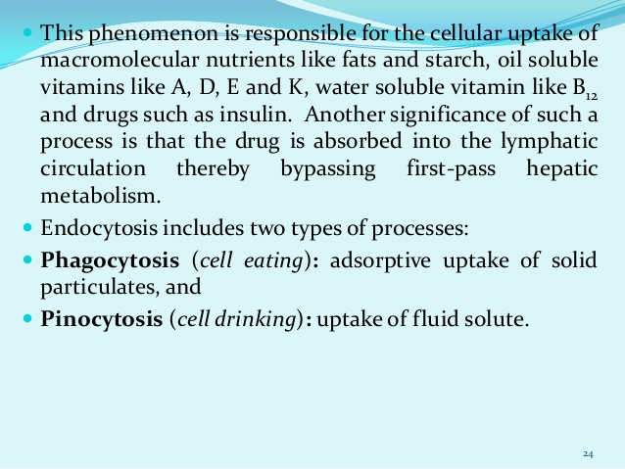

Slide 27
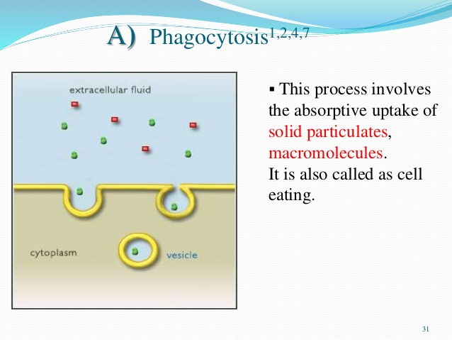

Slide 28
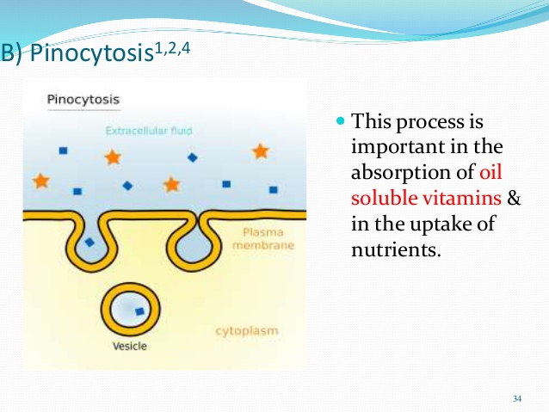

Slide 29
