Slide 1
INSTRUMENTATION OF
Infra red spectrophotometeR
Samreen Begum
Assistant professor
M.Pharm (Pharmaceutical analysis)

Slide 2
Instrumentation
The main parts of an IR spectrophotometer are as follows:
IR radiation sources
Monochromators
Sample cells and sampling of substances
Detectors

Slide 3
The IR Radiation Sources:
In common with other types of absorption spectrometers, infrared instruments require a source of radiant energy which provides a means for isolating narrow frequency bands. The radiation source must emit IR radiation which must be
(i) intense enough for detection
(ii) steady
(iii) extend over the desired wavelengths

Slide 4
Although these radiations are continuous, only selected frequencies will be absorbed by the samples.
The various popular sources of IR radiations are:
Incandescent Lamp.
In the near infrared instruments an ordinary incandescent lamp is generally used.
However, this fails in the far infrared because it is glass enclosed and has a low spectral emissivity.

Slide 5
(b) Nernst Glower.
It consists of a hollow rod which is about 2 mm in diameter and 30 mm in length.
The glower is composed of rare earth oxides such as zirconia, yttria and thoria.
The glower is non-conducting at room temperature and must be heated by external means to commence conductivity.
Glower is generally heated to a temperature between 1000 to 1800°C.
It emits strong radiation at about 7100 cm⁻¹ (1.4 μ).
Advantage
It emits IR radiation over a wide wavelength range
the radiation remains steady and constant over long periods of time.
Disadvantage
Its frequent mechanical failure.
It is also concentrated in the visible and near infrared region of the spectrum.

Slide 6
(c) Globar Source
Made of sintered silicon carbide (≈50 mm length, 4 mm diameter).
Heated to 1300–1700°C, emits strongly in the IR region (maximum at 5200 cm⁻¹).
Self-starting; positive temperature coefficient—easily controlled by a variable transformer.
Works well for wavelengths > 650 cm⁻¹ (0.15 μm).
Disadvantage: Less intense than the Nernst glower
(d) Mercury Arc
Used in the far IR region (< 200 cm⁻¹).
Other sources are ineffective here.

Slide 7
Monochromators
Separate specific IR frequencies absorbed by the sample from the continuous radiation.
Two main types:
Prism Monochromator
Grating Monochromator
(a) Prism Monochromator
Made of metal halide salts (e.g., NaCl), as glass/quartz absorb IR.
Provides high dispersion in 4–15 μm region (important for functional group analysis).
NaCl prism is common but sensitive to moisture, heat, and mechanical damage — requires protection.
Single pass design: Sample placed near the focus of the beam before the entrance slit (A) of the monochromator.

Slide 8
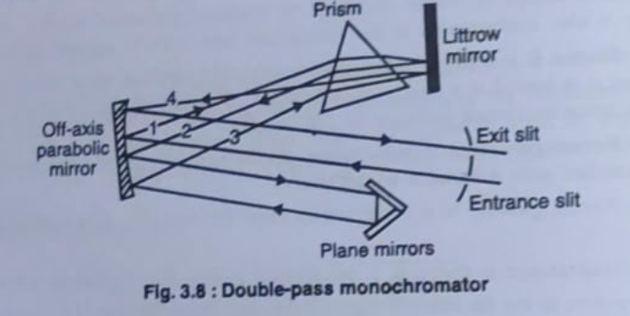
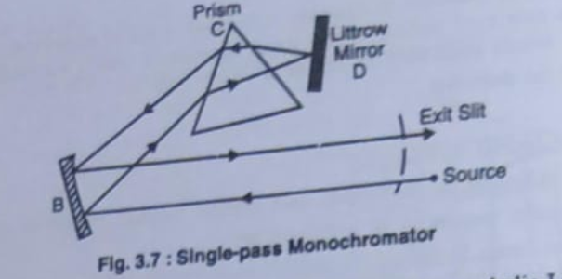
Single-Pass Monochromator
Radiation from the source passes through the sample and entrance slit.
The dispersed beam is reflected by mirror (D) to the exit slit, then to the detector.
Produces moderate resolution.
Double-Pass Monochromator
Radiation passes four times through the prism, increasing resolution.
Shown in Fig. 3.8 – provides better spectral separation before reaching the detector.

Slide 9
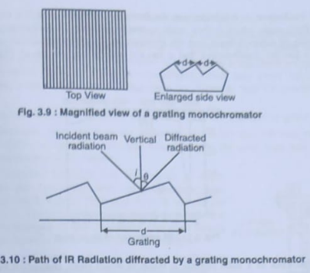
Grating Monochromator
Grating replaces the prism to achieve higher dispersion.
Provide linear dispersion and can be made from various materials.
Different gratings (with various line densities) are used to cover wide IR wavelength ranges.
Combination of gratings and filters improves spectral selection.
Different wavelengths (λ) are dispersed at different angles (θ) — light separation occurs because each wavelength is diffracted at a different angle.

Slide 10
Advantages over Prism Monochromator:
Not affected by moisture – materials like aluminum can be used, unlike metal salt prisms (NaCl, KBr).
Covers a wide wavelength range effectively.
Can be used with small prisms (as order sorters) or filters to improve range and precision.

Slide 11
Sample Cells and Sampling of Substances
Infrared spectroscopy is used for solids, liquids, and gases.
Each requires special handling.
Common requirement: The sample container or material must be transparent to IR radiation.
Typical materials used → NaCl, KBr, depending on the wavelength range.

Slide 12
(a) Sampling of Solids
Four common techniques are used.
(i) Solids Run in Solution
A drop of the solution is placed on an alkali metal disk and the solvent allowed to evaporate, leaving a thin film of the solute, or the entire solution is placed in a liquid sample cell.
If the solution of solid can be prepared in a suitable solvent then the solution is run in one of the cells for liquids.
But this method cannot be used for all solids because suitable solvents are limited in number and there is no single solvent which is transparent throughout the IR region.
When the investigating solids are in solutions, the absorption due to solvent has to be compensated by keeping the solvent in a cell of same thickness as that containing the sample, in the path of the reference beam of double-beam spectrometer.

Slide 13
ii)Solid Films
The amorphous solid sample is deposited as a thin film on the surface of KBr or NaCl cell by evaporation of its solution of the solid.
Rapid and simple method for qualitative analysis, but not suitable for quantitative studies.
iii)Mull Technique
Finely ground solid is mixed with Nujol (mineral oil) to make a thick paste.
The paste is spread between IR transmitting windows and the spectrum is recorded.

Slide 14
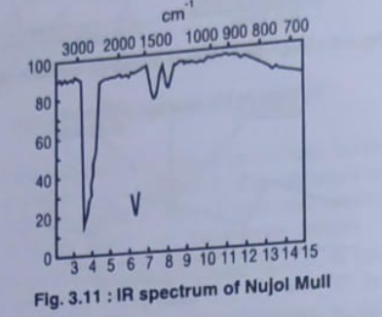
Nujol is transparent in most of the IR region but shows absorption peaks at 2915, 1462, 1376, and 719 cm⁻¹ (Fig. 3.11).
Therefore, overlapping of absorption bands may occur.
Can be used with hexachlorobutadiene (absorbs at different regions: 1630–1510, 1200–1140, and 1010–760 cm⁻¹) to avoid overlap.
Use: Qualitative analysis only.
Limitation: Not suitable for quantitative studies due to interference from Nujol bands

Slide 15
(iv) Pressed Pellet Technique
Finely ground solid sample mixed with ~100 times its weight of powdered KBr.
Mixture is compressed under high pressure (~25,000 psi) to form a thin pellet (1–2 mm thick, 1 cm diameter).
The KBr pellet is transparent to IR radiation and used directly in the spectrometer.
Mixture (KBr + sample) placed in a steel cylinder.
Tightened to form a disc.
The sample pellet is placed in the sample beam path; a blank KBr disc is placed in the reference beam path.

Slide 16
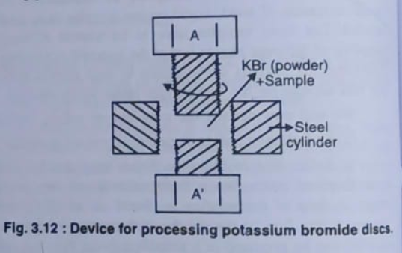
Advantages over Mull Technique:
No interference from mulling agents (Nujol).
Long shelf life – KBr pellets can be stored.
Adjustable sample concentration – allows quantitative analysis.
Better resolution of IR spectra than with mulls.

Slide 17
Disadvantages :
Moisture Band:
It always has a band at 3450 cm⁻¹ from the –OH group of moisture present (always) in the sample. Thus, care must be taken when studying the region of the OH band.
Polymorphic Changes:
The high pressure used during pellet formation may cause polymorphic changes or crystallinity variations, especially in inorganic complexes. In some cases, bromide substitution for chloride may occur in inorganic samples.
Unsuitable for Some Polymers:
This method is not successful for polymers that are difficult to grind with KBr.
From the above, it can be concluded that Nujol Mull method is preferable for crystalline compounds (including complexes), and KBr pellet method may be reserved for non-crystalline solids.

Slide 18
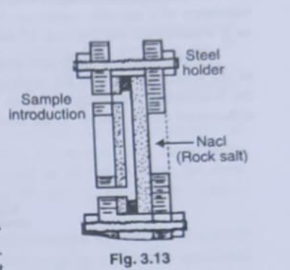

(b) Sampling of Liquids
Liquids at room temperature are usually placed directly (without preparation) into rectangular cells made of NaCl, KBr, or ThBr and their IR spectra are obtained directly(Fig. 3.13).
The sample thickness should be adjusted so that transmittance lies between 15–20%, representing a thin layer of 0.01–0.05 mm.
If a cell has good quality windows, flat and parallel, its thickness t in cm can be calculated using the equation:
where
N = number of fringes between wave numbers v₁ and v₂.
For double-beam instruments, matched cells are used — one with the sample and the other with solvent used in the sample. Both cells must have the same thickness.

Slide 19
All cells must be protected from moisture since salts like NaCl and KBr are water-soluble.
Liquid samples should be dried before use.
Quantitative IR analysis of liquids is less precise than in the UV/visible region due to uncertainty in thickness.
(c) Sampling of Gases
The gas sample cell is similar to the cell for liquid samples in as much as the surfaces in the light path are made of KBr, NaCl, and so on.
To compensate for the small number of molecules of a sample that is contained in a gas, however, the cells are larger; usually they are about 10 cm long, but they may be up to 1 m long. Multiple reflections can be used to make the effective path length as long as 40 m, so that constituents of the gas can be determined. Such a cell is shown in Fig. 3.14.

Slide 20
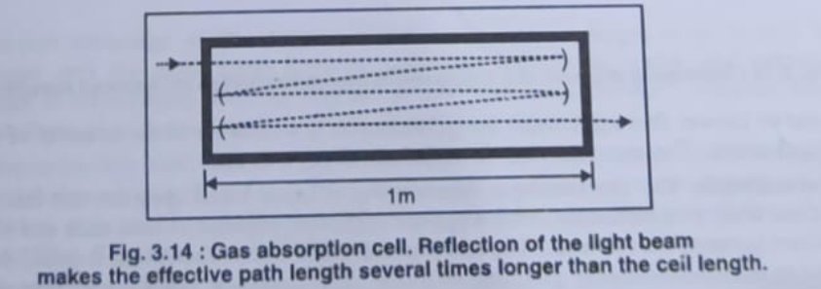
Requirements:
The gas must not react with window materials or reflective surfaces.
Moisture must be avoided, as its strong absorption bands at 3710 cm⁻¹ and 1625 cm⁻¹ interfere with analysis.
Windows and other IR components (especially salts) can be damaged by moisture.

Slide 21
DETECTORS
General Information
In the near-infrared region, photoconductivity cells are generally used.
For other IR regions, thermal detectors are preferred.
Thermal detectors respond to all frequencies.
Since IR radiation has low radiant power, detector signals are weak; thus, preamplifiers are used.

Slide 22
Bolometers
A bolometer is based upon the fact that the electrical resistance of a metal increases approximately 0.4% for every celsius degree increase of temperature.
A bolometer usually consists of a thin metal conductor.
When radiation, such as IR, falls on this conductor, its temperature changes.
As the resistance of a metallic conductor changes with temperature, the degree of change in resistance is regarded as a measure of the amount of radiation that has fallen on the bolometer.
A bolometer is made one arm of the Wheatstone bridge (Fig. 3.15).
A similar strip of metal is used as the balancing arm of the bridge.
This strip is not exposed to IR radiation.

Slide 23
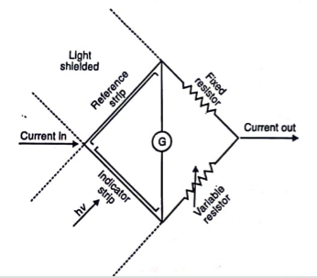
When no radiation falls on the bolometer, the bridge remains balanced.
If IR radiation falls on the bolometer, the bridge becomes unbalanced due to change in the electrical resistance which causes a current to flow through the galvanometer G.
The amount of current flowing through the galvanometer is a measure of the intensity of the radiation falling on the detector.
The response time for a bolometer is 4 m sec.
Schematic diagram of a bolometer –Wheatstone Bridge for infrared detection

Slide 24
Thermocouple
The Thermocouple detector is based upon the fact that an electrical current will flow when two dissimilar metal wires are connected together at both ends and a temperature differential exists between the two ends.
The end exposed to the infrared radiation is called the “hot junction.”
In order to increase the energy gathering efficiency, it is usually a “black body.”
The other connection, the “cold junction,” is thermally insulated and carefully screened from stray light.
The electricity which flows is directly proportional to the energy differential between the two connections.
A thermocouple is made by welding together at each end two wires of different semiconductors materials of high thermoelectric efficiency.
If two welded joints are kept at different temperatures, a small electrical potential is developed between the joints.
A thermocouple is closed in an evacuated steel casing with a KBr (or CsI) window to avoid losses of energy by convection.

Slide 25
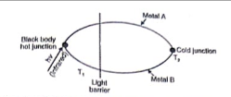
In the IR spectroscopy, one welded joint (called cold junction) is kept at a constant temperature and is not exposed to IR radiation, but the other welded joint (called hot junction) is exposed to the IR radiation which increases the temperature of the junction.
The temperature difference between the two junctions generates potential difference which depends on how much IR radiation falls on the hot junction.
The response time of a thermocouple is about 60 m sec.
THERMOCOUPLE

Slide 26
Thermistors
A thermistor is made of a fused mixture of metal oxides.
As the temperature of the mixture increases, its electrical resistance decreases (as opposed to the bolometer).
This relationship between temperature and electrical resistance allows thermistors to be used as IR detectors in the same way as bolometers.
The thermistor typically changes resistance by about 5% per °C.
Its response time is also slow.

Slide 27
Golay Cell
The Golay detector is used in many commercial spectrophotometers.
It has a small metal cylinder closed at one end by a blackened metal plate and at the other by a flexible metalized diaphragm.
The cylinder is filled with xenon gas and then sealed.
When infrared radiation falls on the black plate, it heats the gas, causing it to expand.
The expanding gas increases pressure, which pushes the diaphragm.
A lamp light shines on the diaphragm, and the reflected light goes to a photocell.
When the diaphragm moves, the amount of reflected light changes, so the photocell signal varies according to the IR radiation.
This means the detector’s output depends on the intensity of the IR beam hitting it.
The Golay detector has similar sensitivity to a thermocouple detector in the mid-IR region.
It works best for wavelengths above 15 micrometers (µm).
However, it is expensive, large, and less convenient than other detectors.

Slide 28
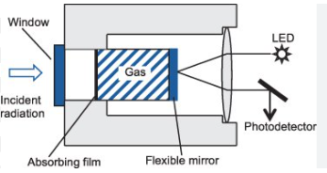
Advantages
Its useful wavelength range is very wide.
The response is linear over the entire range from the ultraviolet through the visible and infrared into the microwave range to wavelengths about as long as 7.0 mm.
The Golay detector’s response time is about 10⁻² sec, much faster than that of the bolometer, thermistor, or thermocouple.
It is best suited when working at wavelengths greater than about 15 µ.

Slide 29
(e) Photoconductivity Cell
This is a non-thermal detector of greater sensitivity.
It consists of a thin layer of lead sulphide or lead telluride supported on glass and enclosed into an evacuated glass envelope.
When IR radiation is focussed on lead sulphide or lead telluride, its conductance increases and causes more current to flow.
Response time is 0.5 m sec.
Photoconductivity cell has high sensitivity and good speed of response in infrared detection, but it suffers from many practical disadvantages.
When operated at room temperature, it has a very restricted range, usually limited to the near infrared.
The range can be broadened by drastic cooling.

Slide 30
(f) Semiconductor Detectors
Semiconductor are materials that are insulators when no radiation falls on them, but which become conductors when radiation falls on them.
Exposure to radiation causes very rapid change in their electrical resistance and therefore a very rapid response to the IR signal.
The basic concept behind this system is that an IR photon displaces an electron in the detector, changing its In order to do this, the photon must have sufficient energy to displace the electron.
For this reason, early semiconductors were limited in the wavelength range over which they were applicable.
For example, lead sulphide detectors were sensitive to radiation with wavelengths as long as 3 µm, but were insensitive to longer wavelengths.
Such detectors had a very limited application, except in the near IR.

Slide 31
More recently, other materials such as lead telluride, indium antimonide, and germanium doped with copper or mercury have been used as semiconductor detectors.
Doped germanium detectors cooled in liquid helium are sensitive to radiation with wavelengths as long as 120 µm, and for this reason are very popular.
This range covers more than the entire IR range.
There are other semiconductors that can be used at room temperature which are sensitive to a lower range of wavelengths, but are nevertheless sensitive over the entire IR range.
In general, a semiconductor detector is fabricated with the semiconductor material deposited onto glass in a sealed, evacuated envelope.
Exposure to radiation causes a rapid change in the material’s conductivity.
The response time of this detector is the time required to change the semiconductor from an insulator to a conductor, which is frequently as short as 1 msec.
This fast response time is a valuable attribute and has enabled fast-scan infrared to become reality.

Slide 32
Pyroelectric Detectors
Principle:
The pyroelectric detector works on the pyroelectric effect, which is the ability of certain crystalline materials (like triglycine sulfate – TGS, lithium tantalate, etc.) to generate a temporary voltage when they are heated or cooled.
When infrared (IR) radiation falls on the crystal, its temperature changes, causing a change in polarization within the material.
This change in polarization results in a flow of current (voltage signal) that is proportional to the amount of incident IR radiation.

Slide 33
Construction:
The detector consists of a thin pyroelectric crystal coated on both sides with conductive electrodes.
It is usually enclosed in a vacuum or inert atmosphere to prevent moisture damage.
The output is connected to a pre-amplifier to convert the weak signal into a measurable voltage.

Slide 34
Working:
Incident IR radiation periodically falls on the pyroelectric crystal (usually modulated by a chopper to produce an alternating signal).
The absorbed radiation changes the temperature of the crystal.
This causes a change in spontaneous polarization of the crystal material.
The change in polarization induces a charge displacement, which appears as a current pulse across the electrodes.
The resulting alternating current signal is amplified and recorded as a measure of the IR radiation intensity.
Widely used in FTIR (Fourier Transform Infrared) spectrometers.
Also used in thermal imaging, motion detectors, and IR sensors.

Slide 35
Fourier Transform Systems
If we regard light as a wave, we accept that it has wavelength.
If two beams of light of the same wavelength are brought together in phase, the beams reinforce each other (constructive interference).
If they are out of phase, they cancel each other (destructive interference).
This principle forms the basis of Fourier Transform Infrared (FTIR) spectroscopy.
The interferometer splits the light beam into two — one reflected from a fixed mirror, the other from a moving mirror.
When recombined, the difference in path length produces interference patterns (interferograms).
The interferogram is mathematically transformed (Fourier Transform) to obtain the infrared spectrum.
He-Ne laser is used for alignment and calibration of the moving mirror.

Slide 36
If the two beams are out of phase, destructive interference occurs, and the light path continues down the spectrometer.
This interference is the basis of Fourier transform spectrophotometers.
The system consists of two paths of light at right angles to each other with a beam splitter at the intersection point.
The beam splitter divides the radiation into two perpendicular half-beams of equal intensity.
These beams travel along different paths, reflect off mirrors, and then recombine at the beam splitter.
The recombined beams are reflected together to the detector.
If the initial radiation is at one wavelength and in phase, the beams reinforce each other when paths are equal in length, giving a maximum signal.
When the mirror in one arm is moved by one-quarter wavelength, the beams become out of phase and interfere destructively.
The moving mirror produces a cosine wave signal with maxima and minima corresponding to constructive and destructive interference.
The frequency of the cosine signal is given by:

Slide 37
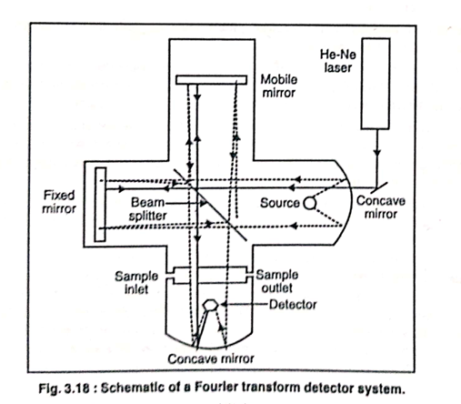

Slide 38
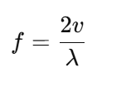
where
f = frequency
v = velocity of the moving mirror
λ = wavelength of radiation
The frequency of modulation is proportional to both the wavelength of radiation and the velocity of the mirror.
Repeated bursts of radiation of all wavelengths travel through the interferometer and reach the detector, where sample absorption occurs.
The mirror movement must be precisely controlled; this is achieved using a laser beam to regulate its velocity.
Advantages of Fourier Transform Spectrophotometer:
  The sample is exposed to the entire radiation beam simultaneously.
  Increases sensitivity and accuracy in measuring absorption wavelengths.
  Offers multiplex advantage, meaning absorption effects at all wavelengths modify the final signal.
  More accurate than conventional monochromator spectrophotometers.
  Greater intensity of radiation at the detector.
  Higher resolution, depending on the mirror’s linear movement.
  Faster operation with improved signal-to-noise ratio.

Slide 39
S.No. | Dispersive IR | Fourier Transform IR (FTIR)
1 | There are many moving parts, resulting in mechanical slippage and wear. | Only the mirror moves during an experiment.
2 | Calibration against reference spectra is required to measure frequency. | Use of a laser provides high frequency accuracy (to 0.001 cm⁻¹).
3 | Stray light within the instrument causes spurious readings. | Stray light does not affect the detector, since all signals are modulated.
4 | In order to improve resolution, only a small amount of the IR beam may be allowed to pass through the slits. | A much larger beam may be used at all times. Data collection is easier.
5 | Only radiation of a narrow frequency range falls on the detector at any one time. | All frequencies of radiation fall on the detector simultaneously.
6 | Slow scan speeds make dispersive instruments too slow for monitoring systems undergoing rapid change (e.g., gas chromatographic effluents). | Rapid scan speeds permit monitoring sample undergoing rapid change.
7 | The sample is subject to thermal effect from the focused beam. | The sample is not subject to thermal effects.
8 | Any emission of IR radiation by the sample will fall on the detector. | Any emission of IR radiation by the sample will not be detected.

Slide 40
Single Beam and Double Beam Spectrophotometers
Single Beam System (Fig. 3.19)
Radiation is emitted by the source, passes through the sample, then through a fixed prism and a rotating Littrow mirror.
Prism and Littrow mirror select the desired wavelength and transmit it to the detector.
The detector measures the intensity of radiation after passing through the sample.
Knowing the original radiation intensity, the amount of absorbed radiation can be determined.
The absorption spectrum is obtained by measuring absorption at various wavelengths.
Disadvantages
Intensity of emission of the radiation source varies from point to point, causing deformation of the spectrum.
Correction for continuous variation of slit is cumbersome.
When samples are analyzed in solution, solvent bands appear in the spectrum.
Spectrum of the sample is obtained by subtracting the solvent spectrum from the resultant spectrum.
Both spectra must be recorded under identical conditions (e.g., thickness of layer).

Slide 41
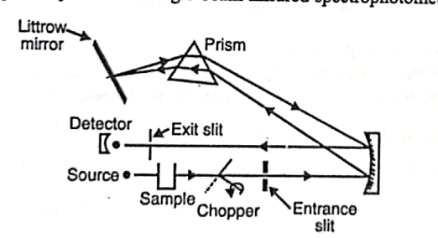
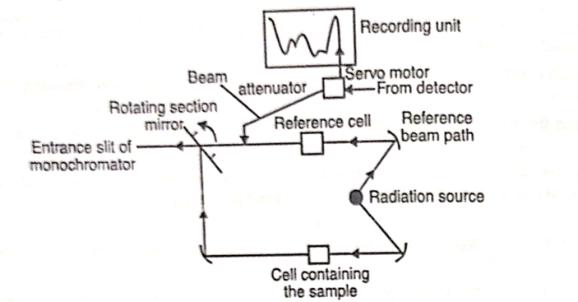
DOUBLE beam Infrared Spectrophotometer
Single beam Infrared Spectrophotometer

